Slide 1

Lecture 4:
CMOS Implementation of logic blocks and sequential elements

Slide 2
Signal Strength
Strength of signal
  How close it approximates ideal voltage source
V_{DD} and GND rails are strongest 1 and 0
nMOS pass strong 0
  But degraded or weak 1
pMOS pass strong 1
  But degraded or weak 0
Thus nMOS are best for pull-down network
And, pMOS are best for pull-up network
1: Circuits & Layout

Slide 3
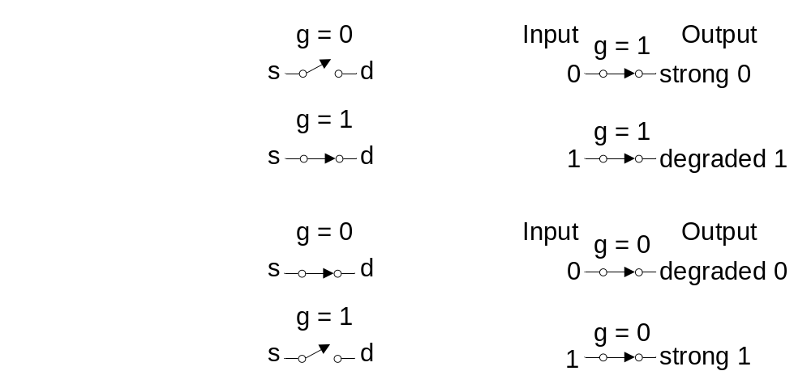
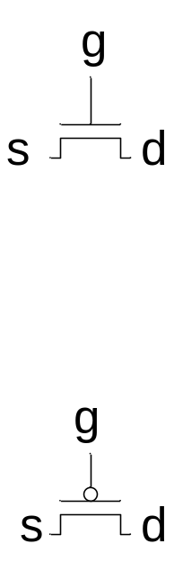
Pass Transistors
Transistors can be used as switches
1: Circuits & Layout

Slide 4
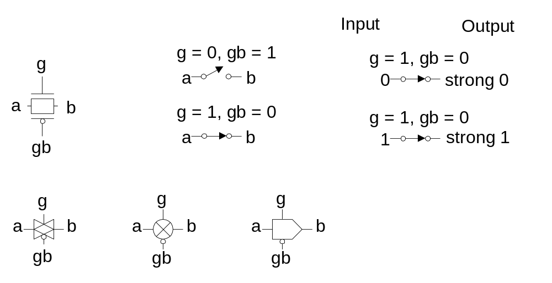
Transmission Gates
Pass transistors produce degraded outputs
Transmission gates pass both 0 and 1 well
1: Circuits & Layout

Slide 5
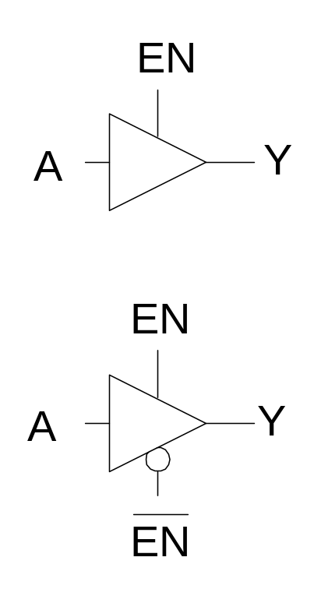
Tristates
Tristate buffer produces Z when not enabled
EN | A | Y
0 | 0 | Z
0 | 1 | Z
1 | 0 | 0
1 | 1 | 1
1: Circuits & Layout

Slide 6
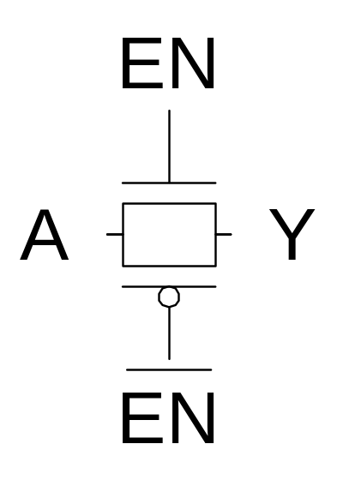
Nonrestoring Tristate
Transmission gate acts as tristate buffer
  Only two transistors
  But nonrestoring
    Noise on A is passed on to Y
1: Circuits & Layout

Slide 7
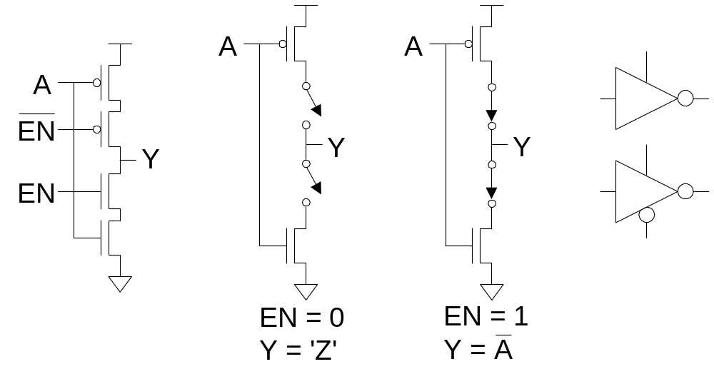
Tristate Inverter
Tristate inverter produces restored output
  Violates conduction complement rule
  Because we want a Z output
1: Circuits & Layout

Slide 8
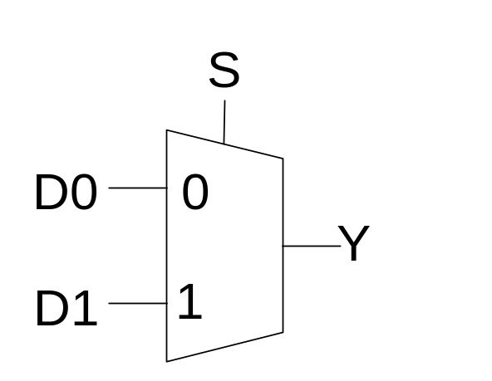
Multiplexers
2:1 multiplexer chooses between two inputs
S | D1 | D0 | Y
0 | X | 0 | 0
0 | X | 1 | 1
1 | 0 | X | 0
1 | 1 | X | 1
1: Circuits & Layout

Slide 9
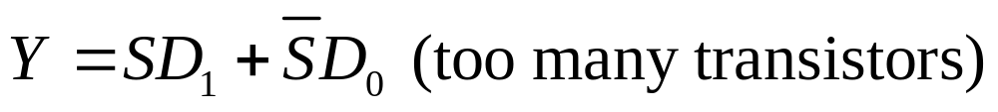
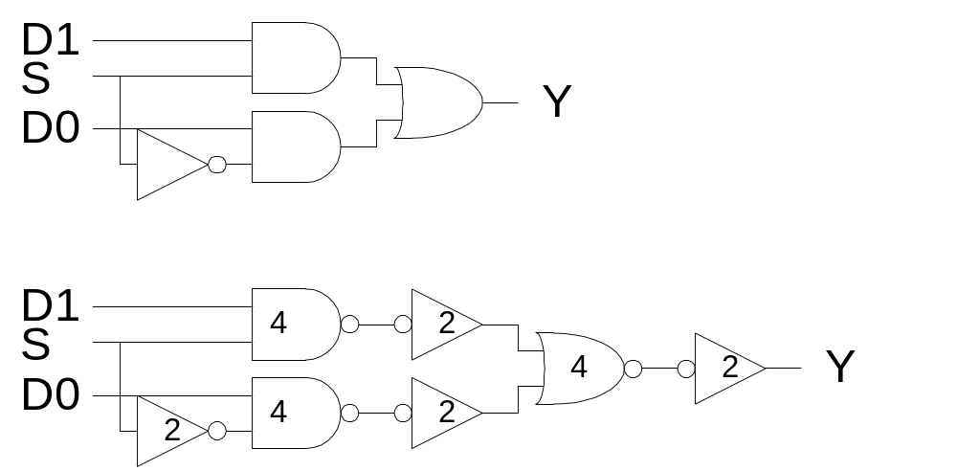
Gate-Level Mux Design
How many transistors are needed? 20
1: Circuits & Layout

Slide 10
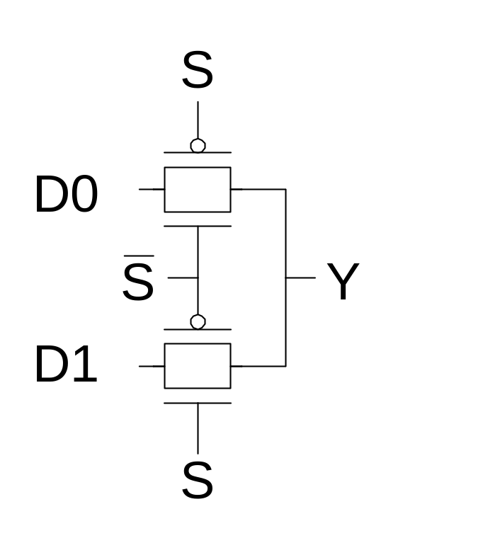
Transmission Gate Mux
Nonrestoring mux uses two transmission gates
  Only 4 transistors
1: Circuits & Layout

Slide 11
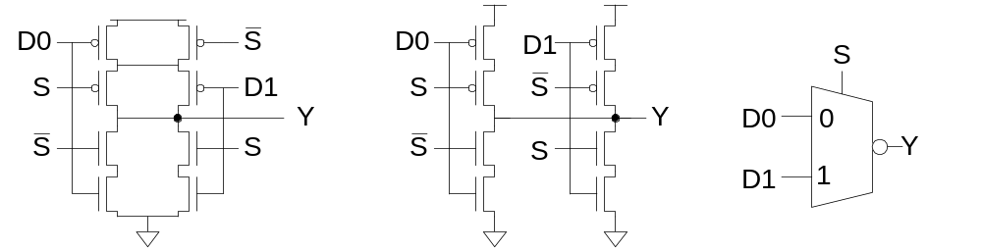
Inverting Mux
Inverting multiplexer
  Use compound AOI22
  Or pair of tristate inverters
  Essentially the same thing
Noninverting multiplexer adds an inverter
1: Circuits & Layout

Slide 12
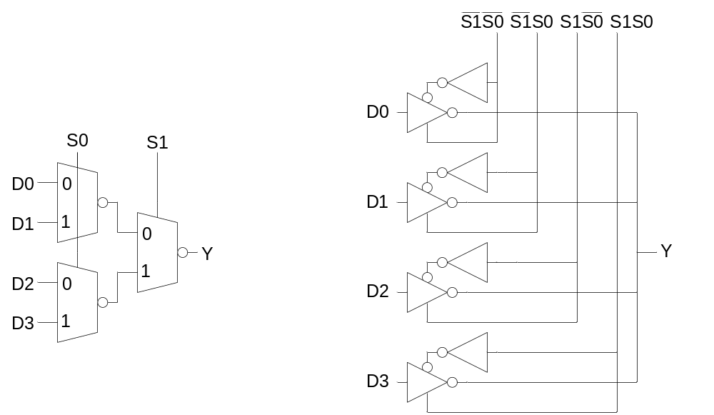
4:1 Multiplexer
4:1 mux chooses one of 4 inputs using two selects
  Two levels of 2:1 muxes
  Or four tristates
1: Circuits & Layout

Slide 13
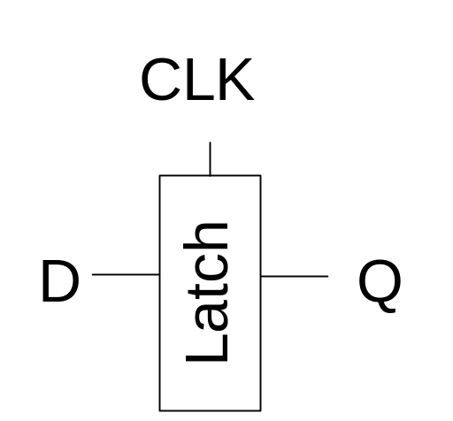
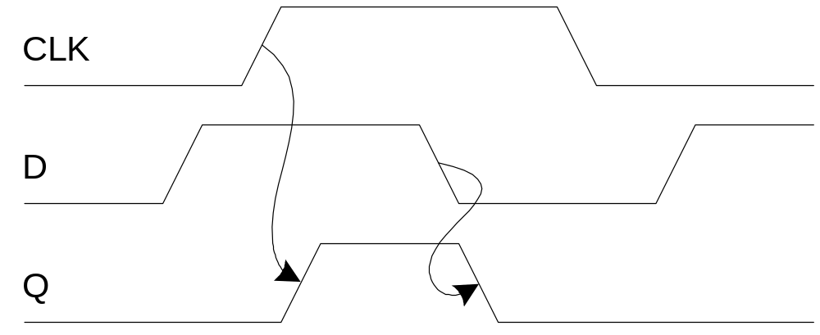
D Latch
When CLK = 1, latch is transparent
  D flows through to Q like a buffer
When CLK = 0, the latch is opaque
  Q holds its old value independent of D
a.k.a. transparent latch or level-sensitive latch
1: Circuits & Layout

Slide 14
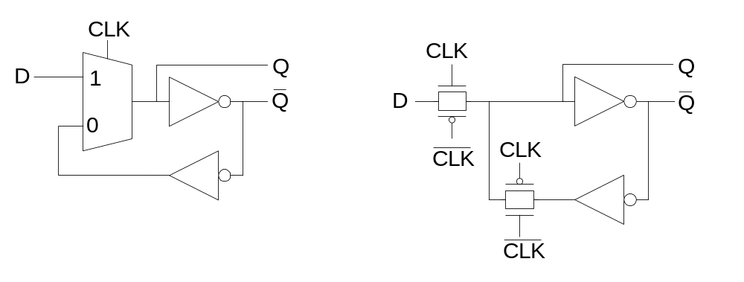
D Latch Design
Multiplexer chooses D or old Q
1: Circuits & Layout

Slide 15
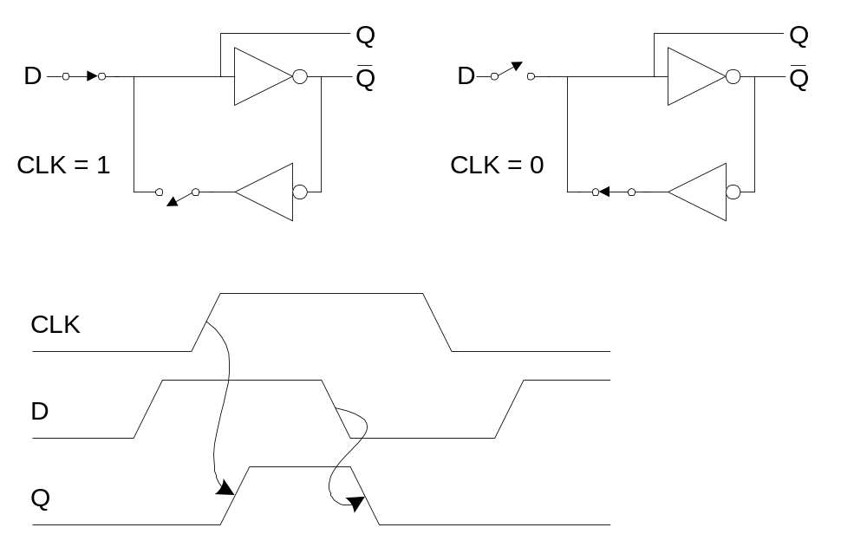
D Latch Operation
1: Circuits & Layout

Slide 16
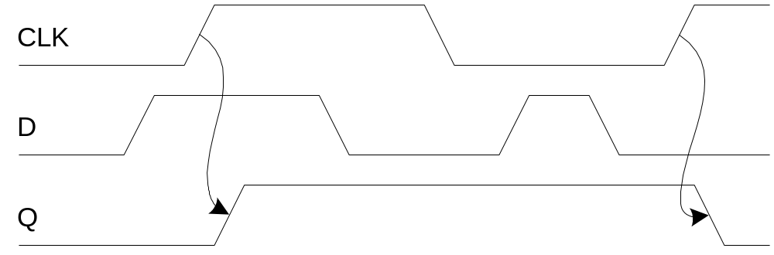
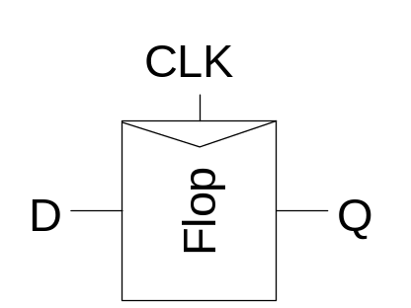
D Flip-flop
When CLK rises, D is copied to Q
At all other times, Q holds its value
a.k.a. positive edge-triggered flip-flop, master-slave flip-flop
1: Circuits & Layout

Slide 17
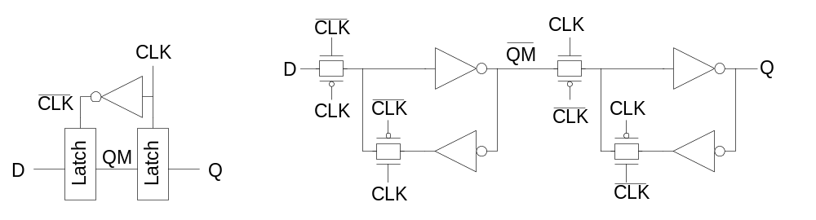
D Flip-flop Design
Built from master and slave D latches
1: Circuits & Layout

Slide 18
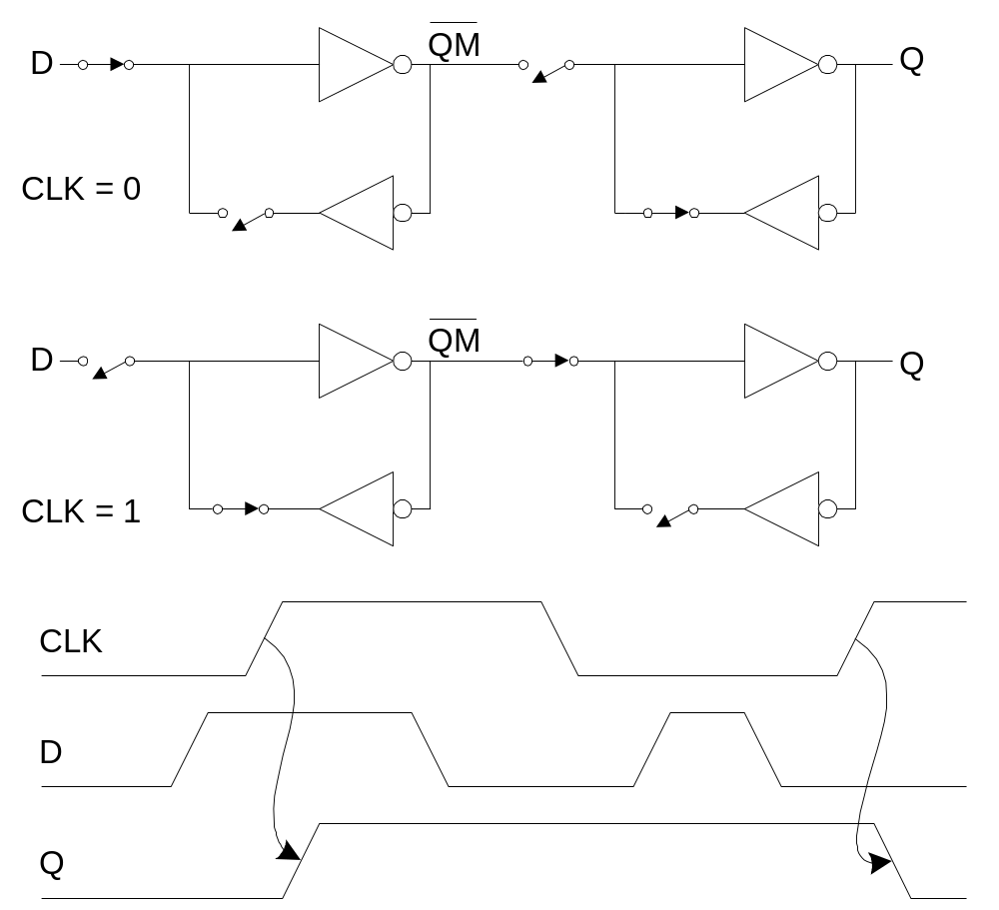
D Flip-flop Operation
1: Circuits & Layout

